Slide 1
Image Restoration
Dr. Rafiqul Islam
Copyright, 1996 © Dale Carnegie & Associates, Inc.

Slide 2
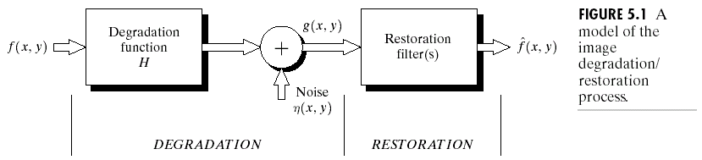
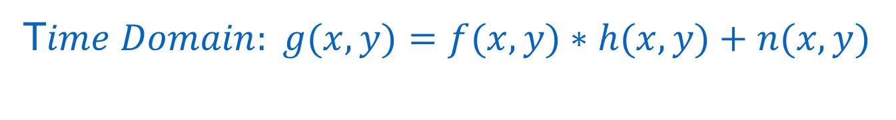
Image Restoration process
T$ime Domain: g(x,y)=f(x,y)∗h(x,y)+n(x,y)$
$$Fourier Domain: G(u,v)=F\left(u,v\right)H(u,v)+N(u,v)$$

Slide 3

Restoration with noise only
$$y=x+n$$
The objective is to find x from y.
Possible solution:
Mean filters
Median filters

Slide 4
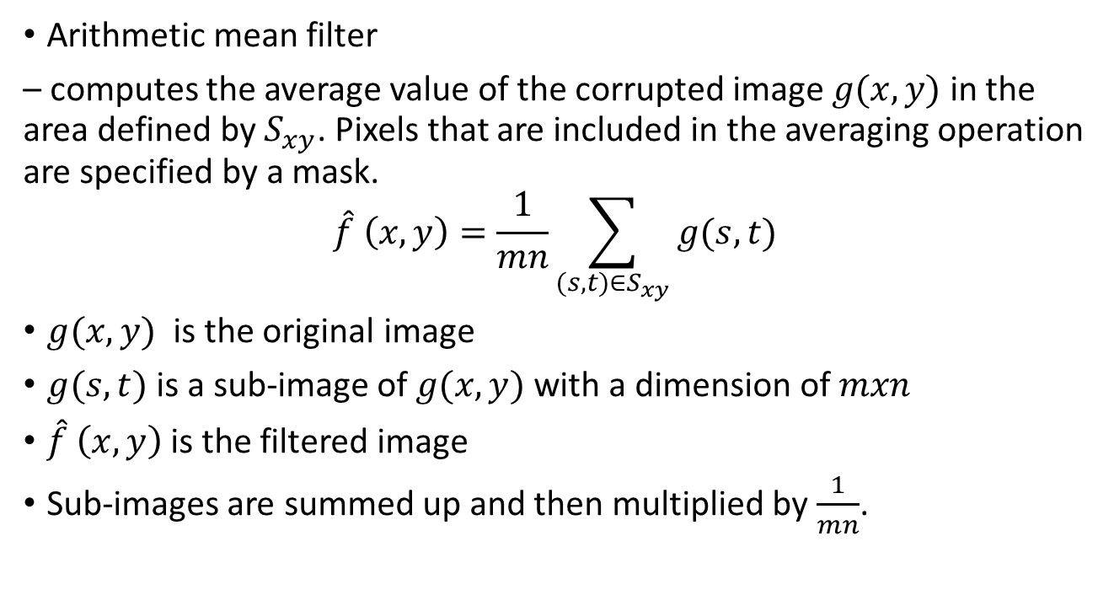
Mean Filter
Arithmetic mean filter
– computes the average value of the corrupted image $g(x,y)$ in the area defined by $S_{xy}$. Pixels that are included in the averaging operation are specified by a mask.
$$\hat{f} \left(x,y\right)=\frac{1}{mn}\sum_{(s,t)∈S_{xy}}{g(s,t)}$$
$g(x,y)$ is the original image
$g(s,t)$ is a sub-image of $g(x,y)$ with a dimension of $mxn$
$\hat{f} \left(x,y\right)$ is the filtered image
Sub-images are summed up and then multiplied by $\frac{1}{mn}$.

Slide 5
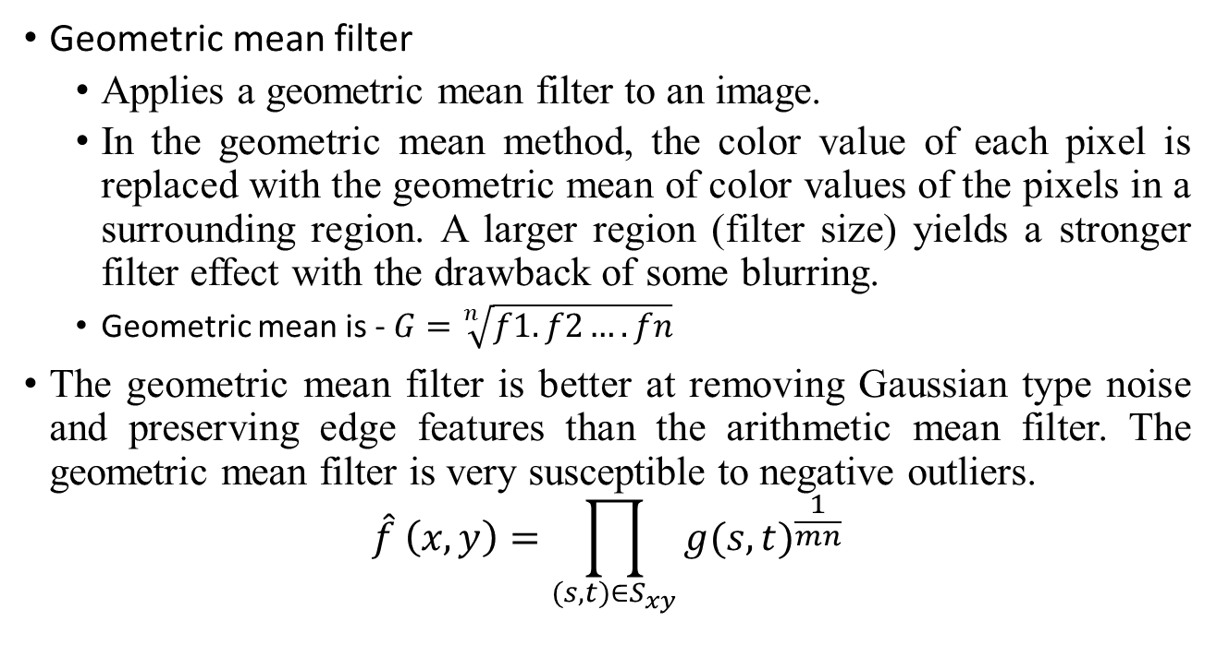
Mean Filter
Geometric mean filter
Applies a geometric mean filter to an image.
In the geometric mean method, the color value of each pixel is replaced with the geometric mean of color values of the pixels in a surrounding region. A larger region (filter size) yields a stronger filter effect with the drawback of some blurring.
Geometric mean is - $G=\sqrt[n]{f1.f2….fn}$
The geometric mean filter is better at removing Gaussian type noise and preserving edge features than the arithmetic mean filter. The geometric mean filter is very susceptible to negative outliers.
$$\hat{f} \left(x,y\right)=\prod_{(s,t)∈S_{xy}}{{g(s,t)}^{\frac{1}{mn}}}$$

Slide 6
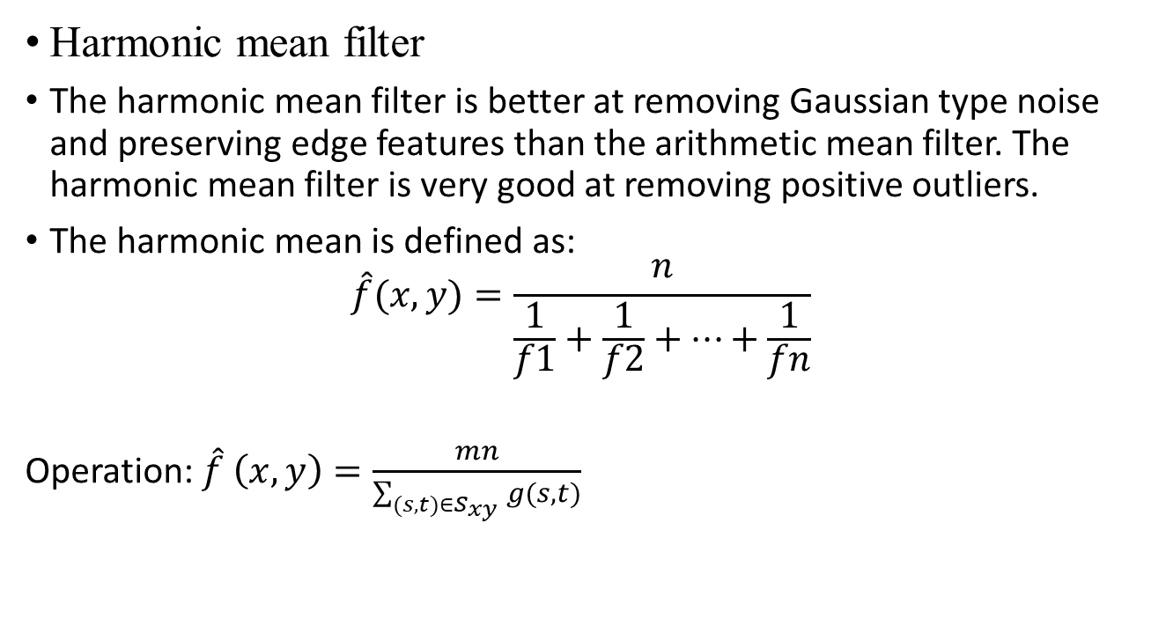
Mean Filter
Harmonic mean filter
The harmonic mean filter is better at removing Gaussian type noise and preserving edge features than the arithmetic mean filter. The harmonic mean filter is very good at removing positive outliers.
The harmonic mean is defined as:
$$\hat{f}(x,y)=\frac{n}{\frac{1}{f1}+\frac{1}{f2}+…+\frac{1}{fn}}$$
Operation: $\hat{f} \left(x,y\right)=\frac{mn}{\sum_{(s,t)∈S_{xy}}{g(s,t)}}$

Slide 7

Median Filter
Median Filter – replaces the value of a pixel by the median of the gray levels in the neighborhood of that pixel:
$\hat{f}\left(x,y\right)=\begin{matrix}\begin{matrix}median \\ (s,t)∈S_{xy}\end{matrix} & \{g(s,t)\}\end{matrix}$
It provide excellent noise-reduction capabilities, with considerably less blurring than linear smoothing filters.

Slide 8

Restoration with blur only
$$y=x∗h$$
The objective is to find x from y.
Possible solution:
Inverse filtering
Wiener filtering

Slide 9
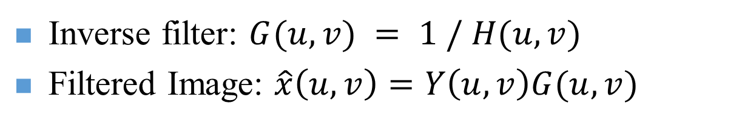
Inverse Filtering
Inverse filtering- the quickest and easiest way to restore that is by inverse filtering. Since the inverse filter is a form of high pass filer, inverse filtering responds very badly to any noise that is present in the image because noise tends to be high frequency.
Inverse filter: $G(u,v) = 1 / H(u,v)$
Filtered Image: $\hat{x}\left(u,v\right)=Y\left(u,v\right)G(u,v)$

Slide 10
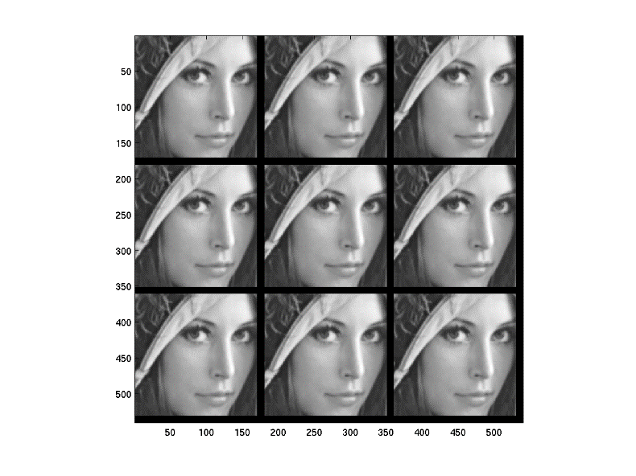
Implementing Inverse Filtering

Slide 11
Lost Information

Slide 12
Problems with Inverse Filtering
H(u,v) = 0, for some u, v
In noisy case,

Slide 13
Wiener Filtering
Wiener filtering- Wiener filter is a filter used to produce an estimate of a desired or target random process by linear time-invariant (LTI) filtering of an observed noisy process, assuming known stationary signal and noise spectra, and additive noise.
The Wiener filter minimizes the mean square error between the estimated random process and the desired process.
The Wiener filtering executes an optimal tradeoff between inverse filtering and noise smoothing. It removes the additive noise and inverts the blurring simultaneously.

Slide 14
Wiener Filter Formulation
Least Mean Square Filter
In practice

Slide 15
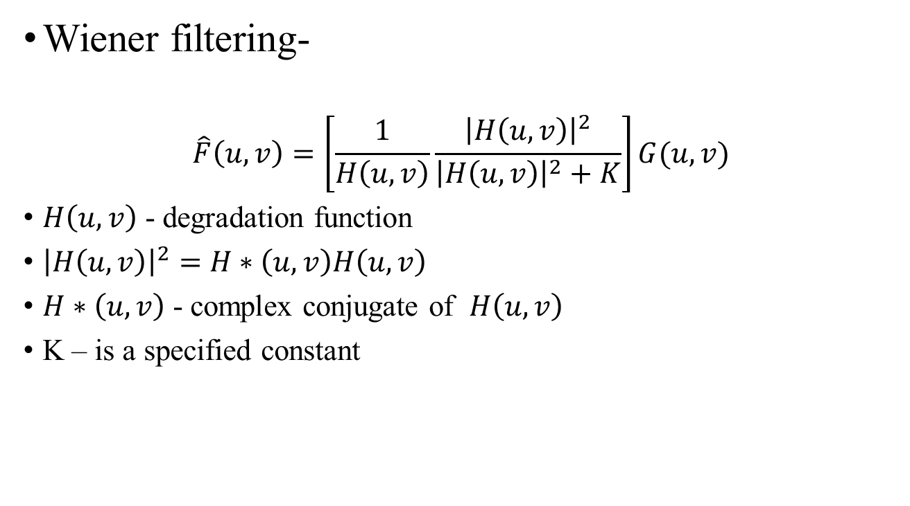
Wiener Filtering
Wiener filtering-
$$\hat{F}\left(u,v\right)=\left[\frac{1}{H\left(u,v\right)}\frac{{\left|H\left(u,v\right)\right|}^{2}}{{\left|H\left(u,v\right)\right|}^{2}+K}\right]G(u,v)$$
$H\left(u,v\right)$ - degradation function
${\left|H\left(u,v\right)\right|}^{2}=$ $H∗\left(u,v\right)H\left(u,v\right)$
$H∗\left(u,v\right)$ - complex conjugate of $H\left(u,v\right)$
K – is a specified constant

Slide 16
Wiener Filter Results

Slide 17
Image Restoration by Thresholding
The basic procedure contains the steps:
Decompose: Choose a wavelet, choose a level N. Compute the wavelet decomposition of the signal at level N.
Threshold detail coefficients: For each level from 1 to N, select a threshold and apply soft thresholding to the detail coefficients.
Reconstruct: Compute wavelet reconstruction using the original approximation coefficients of level N and the modified detail coefficients of levels from 1 to N.
Two points must be addressed in particular:
how to choose the threshold,
and how to perform the thresholding.

Slide 18
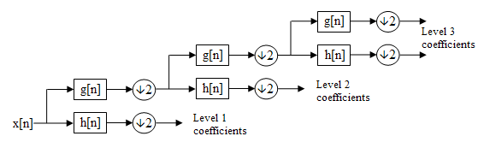
Wavelet Transform
Multi-resolution analysis in frequency domain
Haar
DWT
CWT
An example of 3-level decomposition

Slide 19
Wavelet Transform
The Haar functions are def:ined as

Slide 20
Haar wavelet Transform
Haar transform matrix for sizes N=2,4,8
Can be computed by taking sums and differences.
Fast algorithms by recursively applying Hr_{2.}

Slide 21
Haar wavelet Transform
Haar transform of Main image
Main image

Slide 22
Haar wavelet transform
Matlab Code for Haar wavelet transform
>> load woman;
>> nbcol = size(map,1);
>>[cA1,cH1,cV1,cD1] = dwt2(X,'db1');
>> cod_X = wcodemat(X,nbcol);
>> cod_cA1 = wcodemat(cA1,nbcol);
>> cod_cH1 = wcodemat(cH1,nbcol);
>> cod_cV1 = wcodemat(cV1,nbcol);
>> cod_cD1 = wcodemat(cD1,nbcol);
>> dec2d = [...
cod_cA1, cod_cH1; ...
cod_cV1, cod_cD1 ...
];
>> figure(1), imagesc(X), colormap(gray)
>> figure(2), imagesc(dec2d), colormap(gray)

Slide 23

Thresholding
Hard Thresholding- is defined as :
Threshold (x, λ) = x for all |x|> λ and 0 otherwise.
The soft thresholding operator on the other hand is defined as:
Threshold (x, λ) = $sgn(x) max⁡(0, |x| − λ )$

Slide 24
Matlab Example
Example
x = imread('cameraman.tif');
y = double(x) + 25*rand(size(x));
figure (1), imagesc([x y]);

Slide 25
Matlab Example
Wavelet Example
x = imread('cameraman.tif'); y = double(x) + 25*rand(size(x));
[cA,cH,cV,cD] = dwt2(y,'haar','mode','per');
figure(2), imagesc([cA,cH,cV,cD])

Slide 26
Matlab Example
Threshold Example
x = imread('cameraman.tif'); y = double(x) + 25*rand(size(x));
[cA,cH,cV,cD] = dwt2(y,'haar','mode','per'); T = 0.8;
cD = cD – T; cH = cH - T; cV = cH - T;
imagesc([cA,cH,cV,cD])

Slide 27
Matlab Example
Threshold Example
x = imread('cameraman.tif');
y = double(x) + 25*rand(size(x)); // Adding noise
[cA,cH,cV,cD] = dwt2(y,'haar','mode','per'); // Wavelet Transform
T = 0.8; // Threshold Value
cD = cD – T; cH = cH - T; cV = cH - T; // Thresholding
X = idwt2(cA,cH,cV,cD,'haar'); // Inverse Wavelet Transform

Slide 28
Matlab Link
http://eeweb.poly.edu/iselesni/WaveletSoftware/denoise.html
https://www.mathworks.com/help/wavelet/ref/dwt2.html?searchHighlight=dwt2&s_tid=doc_srchtitle

Slide 29
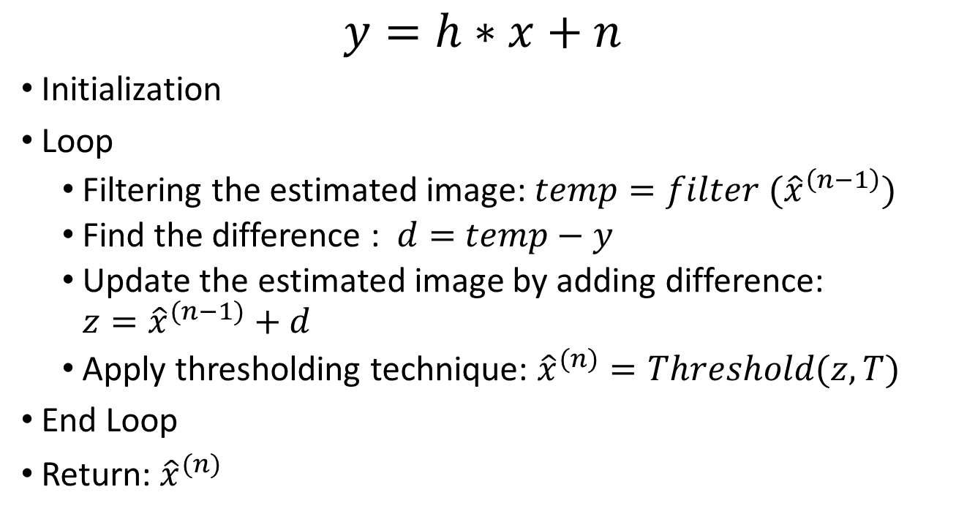
Iterative Restoration Technique
$$y=h∗x+n$$
Initialization
Loop
Filtering the estimated image: $temp=filter ({\hat{x}}^{\left(n−1\right)})$
Find the difference : $d=$ $temp−y$
Update the estimated image by adding difference: ${z=\hat{x}}^{(n−1)}+d$
Apply thresholding technique: ${\hat{x}}^{(n)}=Threshold(z,T)$
End Loop
Return: ${\hat{x}}^{(n)}$

Slide 30
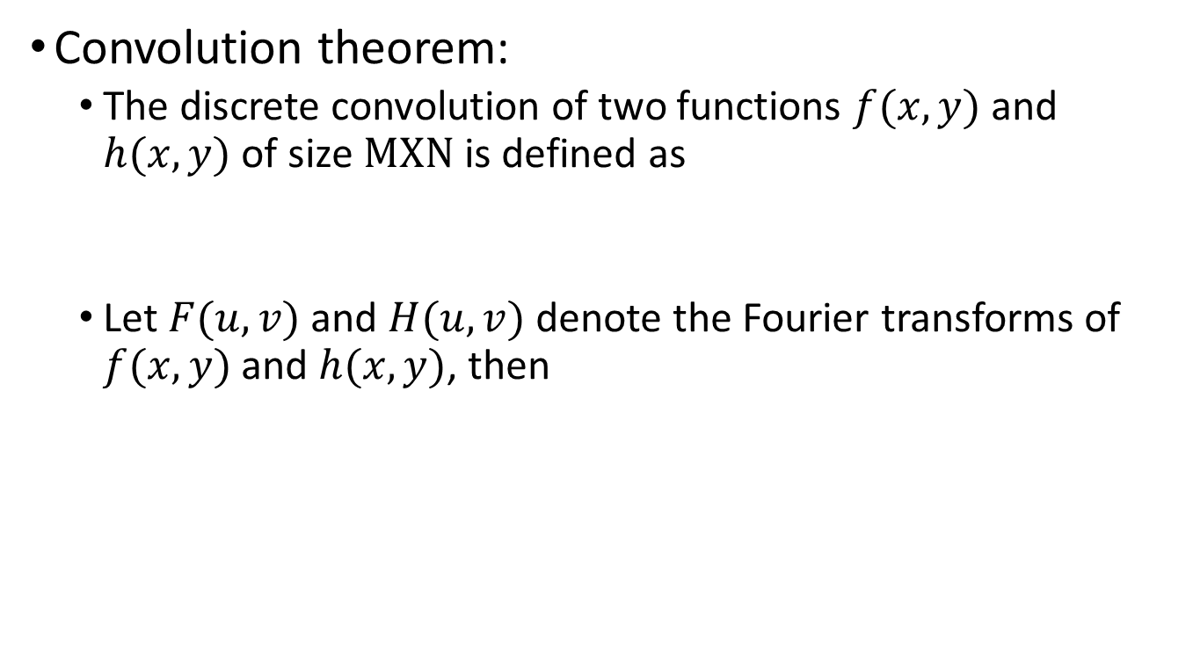
Convolution
Convolution theorem:
The discrete convolution of two functions $f(x,y)$ and $h(x,y)$ of size $MXN$ is defined as
Let $F(u,v)$ and $H(u,v)$ denote the Fourier transforms of $f(x,y)$ and $h(x,y)$, then

Slide 31
Frequency Domain Filtering
Let H(u) denote a frequency domain, Gaussian filter function given the equation
where : the standard deviation of the Gaussian curve.
The corresponding filter in the spatial domain is
Note: Both the forward and inverse Fourier transforms of a Gaussian function are real Gaussian functions.

Slide 32
Some Special Filters
Ideal lowpass filter
Butterworth lowpass filter
Gaussian lowpass filter

Slide 33
Ideal Lowpass Filter
The simplest lowpass filter is a filter that “cuts off” all high-frequency components of the Fourier transform that are at a distance greater than a specified distance D₀ from the origin of the transform.
The transfer function of an ideal lowpass filter
where D(u,v) : the distance from point (u,v) to the center of ther frequency rectangle

Slide 34
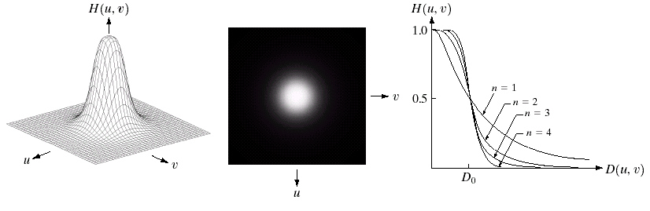
Butterworth Lowpass Filters (BLPFs)
With order n

Slide 35
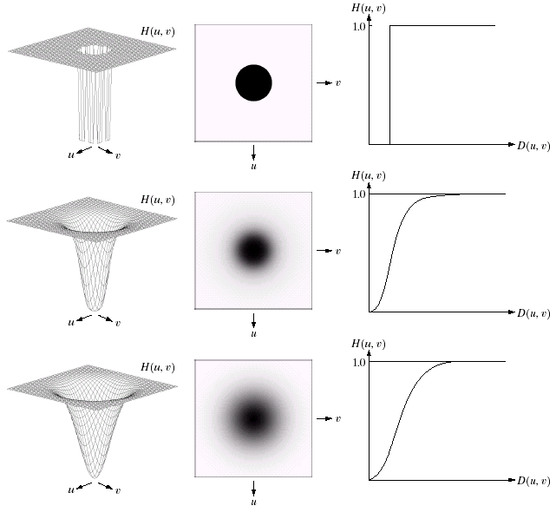
Sharpening Frequency Domain Filter
Ideal highpass filter
Butterworth highpass filter
Gaussian highpass filter

